Slide 1


Message Extensions in Microsoft Teams (Extended lab)

Slide 2








Message extension
Powerful way for users to engage with your app from Microsoft Teams.
Notes:
Message extensions are a powerful way for users to engage with apps from Microsoft Teams. With this capability, users can search and update information, to and from a web service and share the same information, in the form of rich actionable cards, right into a conversation with your teammates.
Some scenarios where this will be useful are:

Slide 3
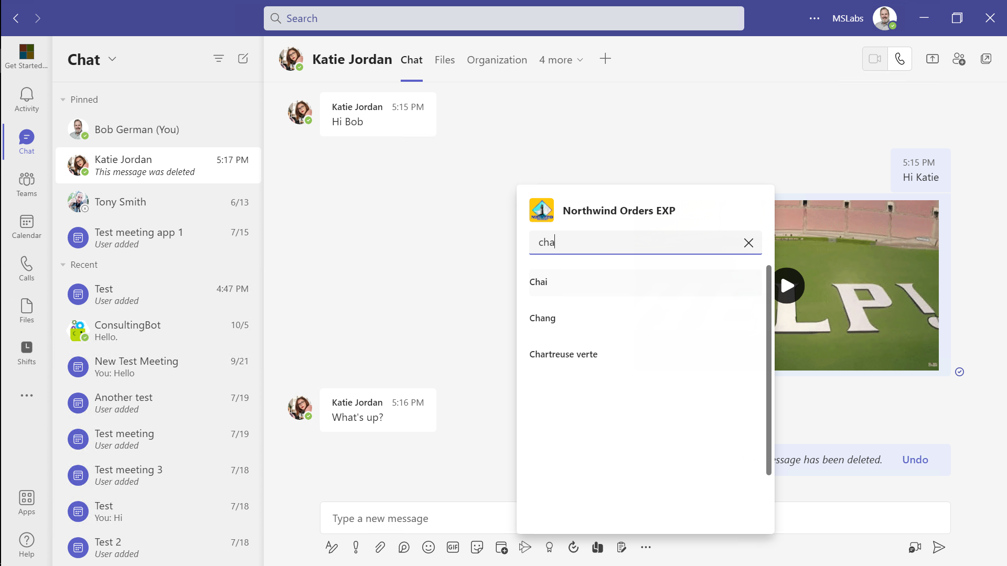
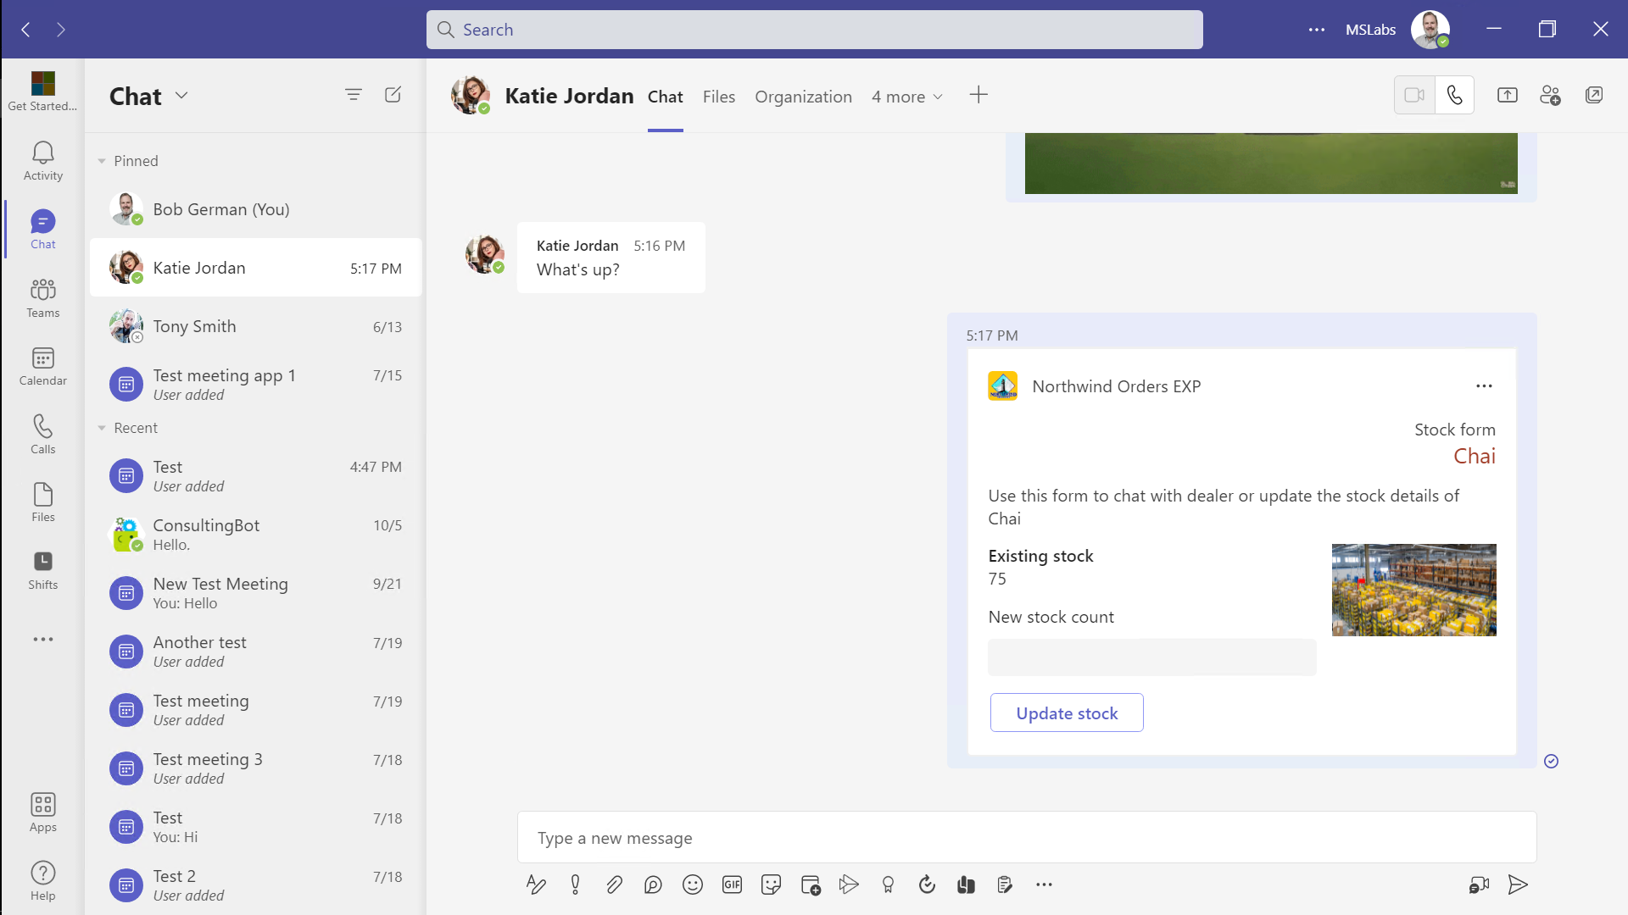
Message Extensions
Extend the menus and commands in Teams
Allow users to include your app in conversation through interactive Adaptive Cards
Collaboration
Employee Experience
Allow users to share and interact with information from your application
Remove copy-and paste hassles
Allow apps to display information when a link is shared in Teams
Streamline work allowing your app to interact inside of chat conversations
Notes:
Suggested demo: Show the completed Messaging Extension lab. Update the inventory using the adaptive card and then check it in the app.

Slide 4






Customer support tickets
Scenarios
Share image/media
Example scenarios
Notes:
Some scenarios where this will be useful are:
To show customer support tickets, to share image and media content etc.

Slide 5
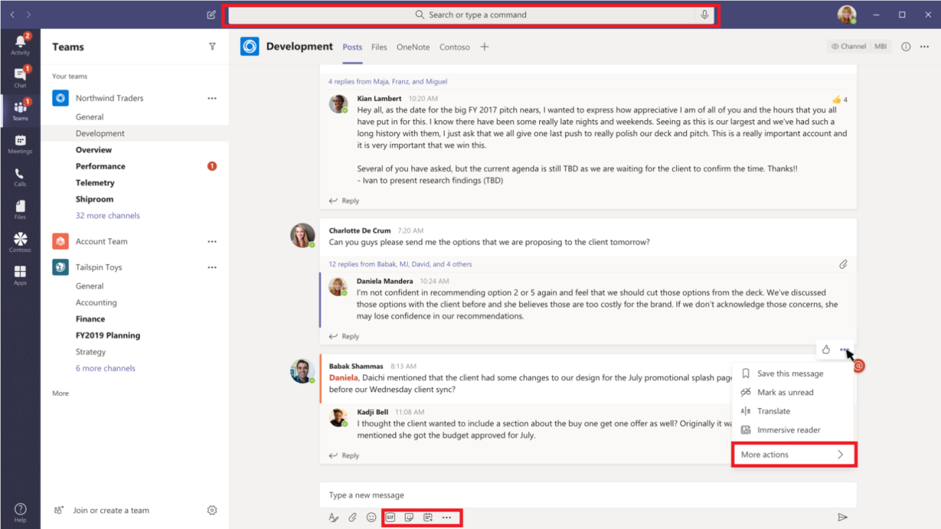
What are messaging extensions?
Search
Do a query
Action Perform an action
Link Unfurling Provide a custom link summary
3
2
1
Notes:
Types of message extensions:
There are three types of message extensions that you can add to your Teams app today:
Search commands - which will query a webservice to get information and insert data from the response into a message.
Scenarios where this is useful – Lookup a product
Action commands – Which will collect information from the user, using a small form or dialog and post that information back to a web service.
Scenario where this is useful – Create a new product
Link unfurling – Allows displaying a custom summary of a hyperlink that’s sent in a Teams chat message. This can be used cleverly to allow users to copy and paste references to business data.

Slide 6




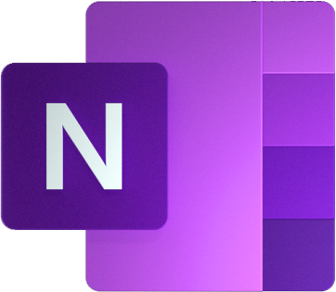



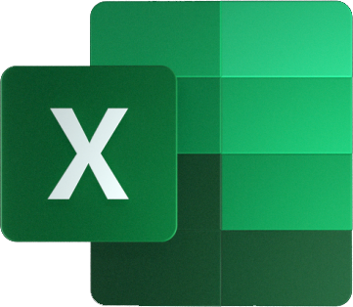



Bot Framework in Teams apps
Azure AD
REST API
Teams Application
Microsoft 365 Data
Your app’s web pages in the Teams client
Teams JavaScript SDK
Microsoft Graph API
REST API
Web content; REST API
Your app’s web servers(s)
Azure Bot Framework
Microsoft Graph SDK
Bot Builder SDK
Message Extensions
Adaptive Card actions
Proactive Bots
Conversational bots
REST API
manifest.json
Notes:
Recall this prototypical Teams app architecture. The app is hosted on an ordinary web server, which serves up web pages to be displayed in tabs, dialogs, and configuration pages.
In addition, it typically provides a REST interface for use by the client apps. The client-side code authenticates itself to the app’s server using an Azure AD access token provided by the Teams JavaScript SDK; the web server validates this token using an Azure AD library.
When the app needs access to content in Teams or other parts of Microsoft 365, it uses the Microsoft Graph API. To call the Graph, it needs an Azure AD access token; the app uses the Oauth 2.0 On Behalf Of flow to swap the incoming access token for a new one that targets the Microsoft Graph.
This works well for many things, but sometimes Teams needs to provide real-time updates to the app, such as when a message extension is clicked or a conversational bot receives a message. This is provided by the Azure Bot Framework, which is well-suited to provide secure real-time messaging between the app and Microsoft Teams.

Slide 7








Channels and Activities
Azure Bot Services
User
Channel
App
Channel
Bot Adapter (ot Builder SDK)
Channel
REST services
Activities
- Message
- Invoke (message ext.)
- Conversation Update - Typing - Delete User Data - Contact Relation Update
Messages
- Text - Rich attachments (e.g. images)
- Custom format (e.g. adaptive cards)
Notes:
The Azure Bot Framework provides communication between a collaboration program such as Teams, Slack, Twilio, or Facebook Messenger, and a bot.
Microsoft Teams requires the use of Azure Bot Framework for implementing bots; a bot “channel” connects a bot-hosting application with your bot code.
Your application sends and receives activities. A conversational message is sent as a “Message” activity; an adaptive card is sent as an attachment to a “Message” activity.
Message extensions and adaptive card actions are sent to your app in Invoke activities. For example, if a user clicks on your message extension, Teams sends an Invoke activity through the Azure Bot channel to your application.
The easiest way for your application to communicate with the Azure Bot channel is via a Bot Framework Adapter object in the Bot Builder SDK. This is available for NodeJS, .NET, Python, and Java. It’s also possible to implement the REST interface to the Bot Channel manually, which is more work but allows binding to any language that can send and receive REST calls.

Slide 8





Adaptive cards
Help design and integrate light-weight UI
Increase engagement and efficiency by injecting your actionable content
Platform-agnostic snippets of UI, authored in JSON
Always native and blend seamlessly into the surrounding UI -
Notes:
Adaptive cards are platform-agnostic snippets of UI, authored in JSON, that apps and services can openly exchange
They help design and integrate light-weight UI for all major platforms and frameworks.
They help you increase engagement and efficiency by injecting your actionable content directly into the apps.
They are always native and blend seamlessly into the surrounding UI - and they work on every major platform.
Navigate to the Adaptive Card Designer to demo how to author cards - https://www.adaptivecards.io/designer/

Slide 9
Quick intro to the bot framework
The bot framework is composed of 3 components:
The channels – e.g. Microsoft Teams
The bot service – that receives / sends messages (or cards) from / to your bot
The bot SDK – that help you build the bot app and interact with the bot service
Configuration
Development
Teams message extension, like any integration into a Teams conversation, is built upon the bot framework
You can integrate the bot services REST API directly but the bot SDK (C#, JS, TS, Python) makes this integration much easier – You can for instance use the bot framework “adapter” and reuse your bot logic.

Slide 10
Activation of the bot adpater on your web server
import express from "express";
import {StockManagerBot} from './bot.js';
import { BotFrameworkAdapter } from 'botbuilder’;
const app = express();
//message extension
const adapter = new BotFrameworkAdapter({
appId: process.env.BOT_REG_AAD_APP_ID,
appPassword:process.env.BOT_REG_AAD_APP_PASSWORD
});
const stockManagerBot = new StockManagerBot();
// Catch-all for errors.
const onTurnErrorHandler = async (context, error) => {
console.error(`\n [onTurnError] unhandled error: ${ error }`);
};
// Set the onTurnError for the singleton BotFrameworkAdapter.
adapter.onTurnError = onTurnErrorHandler;
app.post('/api/messages', (req, res) => {
adapter.processActivity(req, res, async (context) => {
await stockManagerBot.run(context);
}).catch(error=>{
console.log(error)
});
});
//start listening to server side calls
const PORT = process.env.PORT || 3978;
app.listen(PORT, () => {
console.log(`Server is Running on Port ${PORT}`);
});
Import statements for the “adapter” of the bot SDK and your bot logic
Create an adapater to the bot service based on the app registration in Azure AD – Requires the client ID and secret
Register a function that manages the errors & exceptions caught by the bot framework adapter (e.g. authent err.)
Activate the POST endpoint that will receive the messages from Teams to your bot – The adapter checks that the authentication header is valid and create a “context” object from the request body. The “context” object is then passed to your bot logic.

Slide 11
Code dive into the bot logic (bot.js)
import { TeamsActivityHandler, CardFactory } from 'botbuilder';
export class StockManagerBot extends TeamsActivityHandler {
//When you perform a search from the message extension app
async handleTeamsMessagingExtensionQuery(context, query) {
...
const heroCard = CardFactory.heroCard(pdt.productName);
...
}
//On preview tap of an item from the list of search result items
async handleTeamsMessagingExtensionSelectItem(context, pdt) {
...
}
//On every activity
async onInvokeActivity(context) {
...
switch (context.activity.name) {
case 'composeExtension/query':
case 'composeExtension/selectItem':
case 'adaptiveCard/action':
default:
}
...
}
}
Import statements from the bot SDK for the Teams activity handlers and Card Factory
Register functions that will be called on specific Teams events – The handle is trigger when a search query is performed – To provide a formatted answer, we use the CardFactory and the card format called “Hero Card”
This handler is called when the Teams event “Item selected from the Message extension list” is triggered
This handler is called on every activity
To know what the activity is, we check its “name” from the “context” info passed by the “adapter” to the bot
'composeExtension/query’ – Seach query sent
'composeExtension/selectItem’ – List item selected
'adaptiveCard/action’ – User action on the adaptive card

Slide 12

demo
Notes:
Lab demonstration:
- Run the messaging extension and update the adaptive card
- Show your bot registration and where values go in the .env file

Slide 13
LAB TIME https://aka.ms/app-camp Add a Message Extension
Notes:
Note there is a video for each lab showing a complete walk-through

Slide 14



Lab Structure
Core Lab (path A)
App setup
Add tab with SSO
Add look and feel
Migrate an Azure AD Web App to Teams
start
Personal tab with
Azure AD SSO
Core Teams Application
Configurable
tab
Deeplinks
Dialog
Meeting App
Message Extension w/Adaptive Cards
Extend capabilities
Notes:
ASK ONE OF THE PARTICIPANTS TO DEMO THE APP

